Slide 1
TIME SERIES ANALYSIS
HARRISBURG UNIVERSITY OF SCIENCE AND TECHNOLOGY
Time series Analysis and Forecasting method of Tesla and Volkswagen stock price

Slide 2


Table of content
Data Overview
01
The data set is historical data downloaded from yahoo finance for both Tesla and Volkswagen from year 2013 July to 2020 July
Computation and Analysis
02
Technical approach
Exploratory Analysis
Hypothesis Test.
Different models
Research Question
03
Analyse and implement various different models
Analyse the forecasted value by using the past datas.
Find the best fit of model
Predict the future value
Associated Tasks
04
Model Development and Evaluation.
Model selection
Prediction

Slide 3

Description of Data
The main aim of this project is to forecast the future stock price of Tesla and Volkswagen motor companies. This both are vehicle based motor companies.
Tesla Inc is an American company specializes in electric vehicle manufacturing, Solar panel and solar roof tile manufacturing. I chose this company because it has good historical data, it is a very known company and because of their field of activity since it is first and foremost a company that manufactures electrical cars, which makes it even more interesting since its products are ecofriendly and thus, represent the future of the automobile.
Volkswagen is a German based automotive manufacturing company specialize in manufacturing passenger, commercial vehicles and motorcycles.
I have used historical stock price data the data from YAHOO Finance of NASDAQ’s official website in the form of an excel sheet, then download it, and import it to R Studio. We are going to use the “Close” price for this analysis. We will analyze the monthly basis dataset
LINK-: dataset can found here

Slide 4
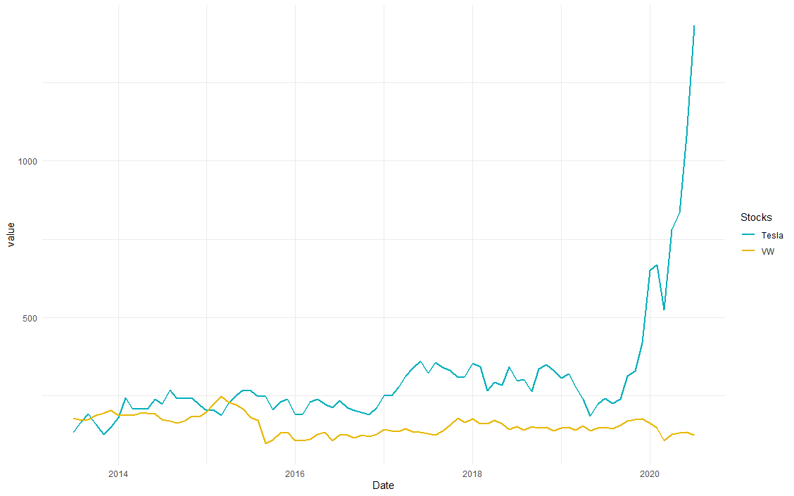
Stock Price of Tesla and VW
Stock price of Tesla and VW of year(2013-2020)
The blue line denotes the monthly Tesla stock price from 2013 to 2020, it seems be have positive trend.
The yellow line denotes the monthly stock piece of Volkswagen(VW) it doesn’t seem to be positive nor negative trend , there is not much fluctuations.
Recent Study says Tesla has overcome Volkswagen become the second most valuable auto company before General Motor.
From the graph we can see Tesla has overcome Volkswagen at the end of 2015

Slide 5
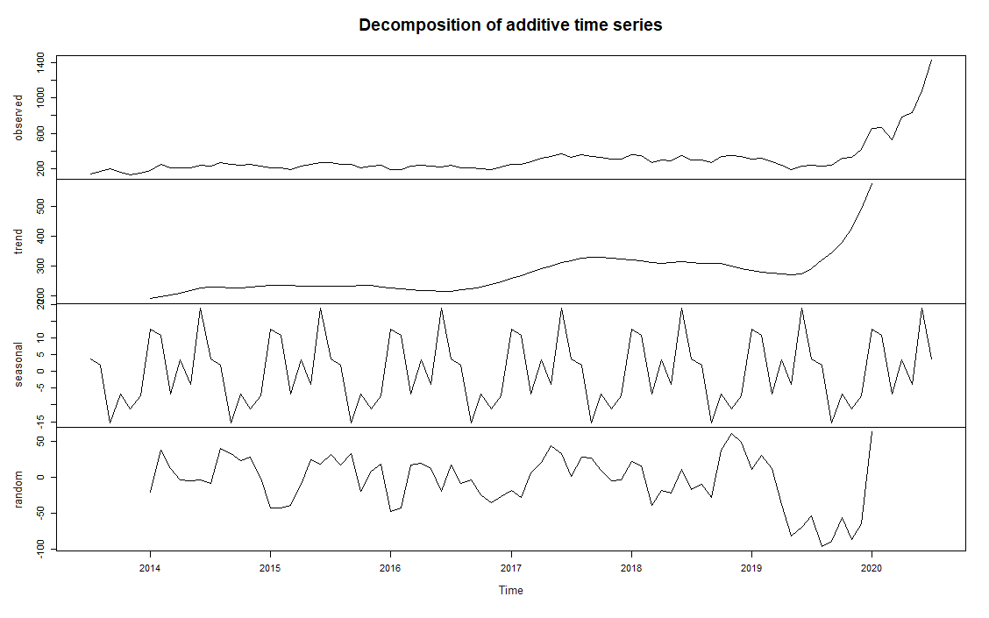
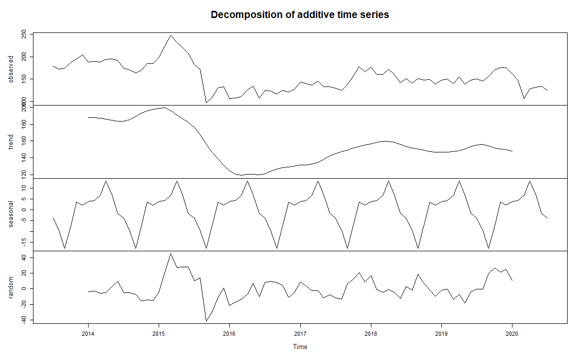
Plotting and Decompose the Time Series
Decomposing a time series means separating it into its constituent components, which are usually a trend component and an irregular component, and if it is a seasonal time series, a seasonal component.
I have used additive decomposition model as the magnitude of the trend-cycle and seasonal components remain constant over the course of the series.
Tesla seems to have a positive tend, whereas VW seems to have a fluctuation.
Our data doesn’t seem to have a seasonal pattern

Slide 6
Stationarity and differencing
I have used Augmented Dickey-Fuller(ADF) to find if the series is stationary or not. The below is the alpha value for both the data.
p > 0, and the process is not stationary.
p = 0, the null hypothesis is rejected, and the process is considered to be stationary.
Our data is non stationary and has unit roots.
Stationarity is an important characteristic of time series. A time series is said to be stationary if its statistical properties do not change over time. In other words, it has constant mean and variance, and covariance is independent of time.
We should have a stationary time series for best fit of model. As,we know our data are non- stationary, we can make different transformations to make them stationary.
I have used logarithms and Differencing methods to transform my non-stationary data to stationary.
TESLA | VOLKSWAGEN
P Value is 0.99 | P Value is 0.2732

Slide 7
Perform Linear Regression Model
By using the differencing and log transformation our data is converted for non-stationary to stationary.
Phillips-ouliaris Cointegration test id performed to check whether our data is cointegration or not
Our stationary data seems to have cointegration so we can further perform the Linear Regression model.
By assuming the Tesla stock as dependent variable and Volkswagen stock as Independent variable I performed the Linear regression model.
Residual standard error: 0.1982 on 81 degrees of freedom
Multiple R-squared: 0.03893, Adjusted R-squared: 0.02706
F-statistic: 3.281 on 1 and 81 DF, p-value: 0.07379
We can see from the above result the p values is greater than alpha value which we fail to reject the null hypothesis.
The result suggest that there is no relationship between the tesla stock and Volkswagen stock and thus this model is not a good model.

Slide 8
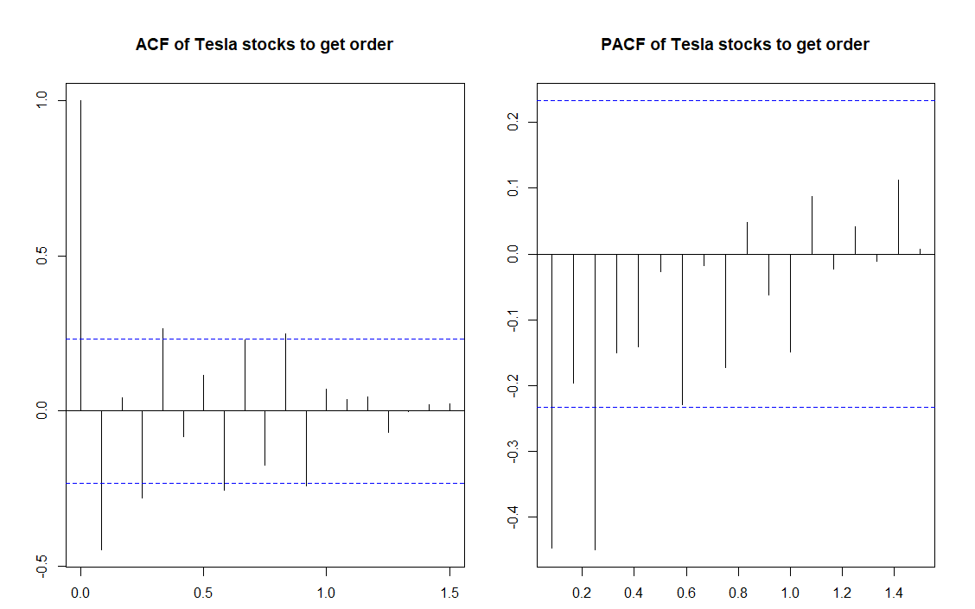
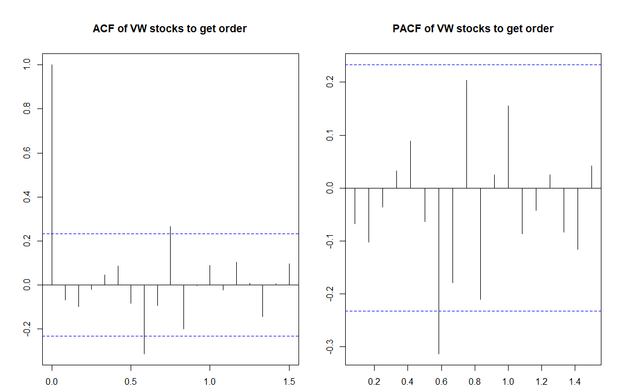
ARIMA MODEL
The time series data is split into training data contains the Tesla and VW stock price from July 2013 to July 2019 and test data contains the Tesla and VW stock price from July 2019 to July 2020.
The ARIMA model is performed on the training data which will help us to predict the value and we can compare with the test data.
To perform the ARIMA model the order is analyzed from the ACF and PACF of the time series of the stationary test data.

Slide 9
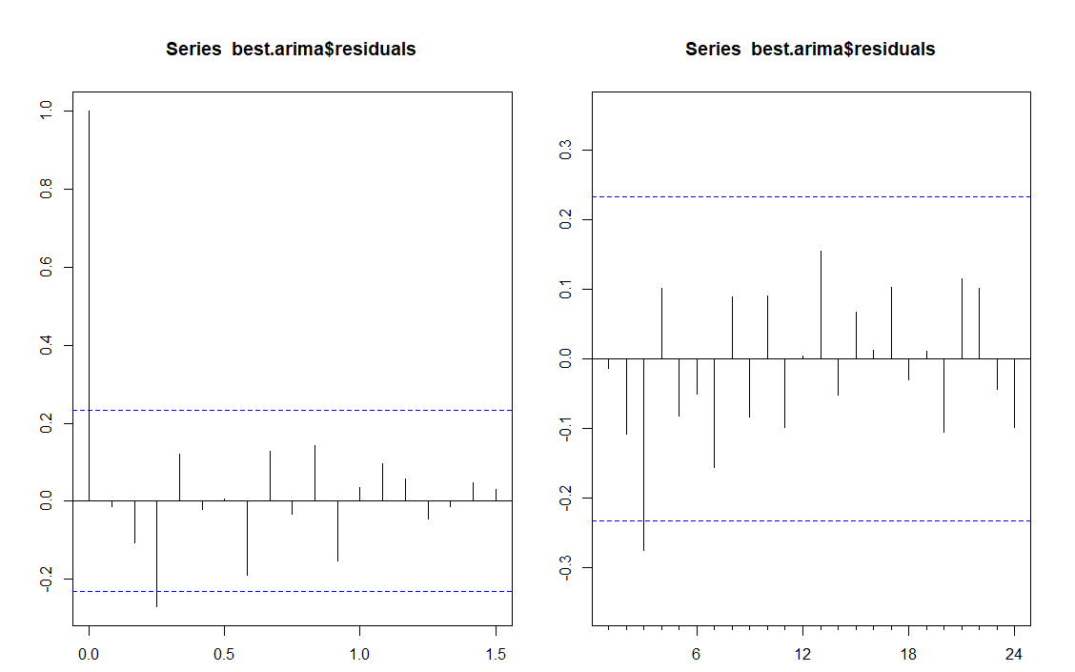
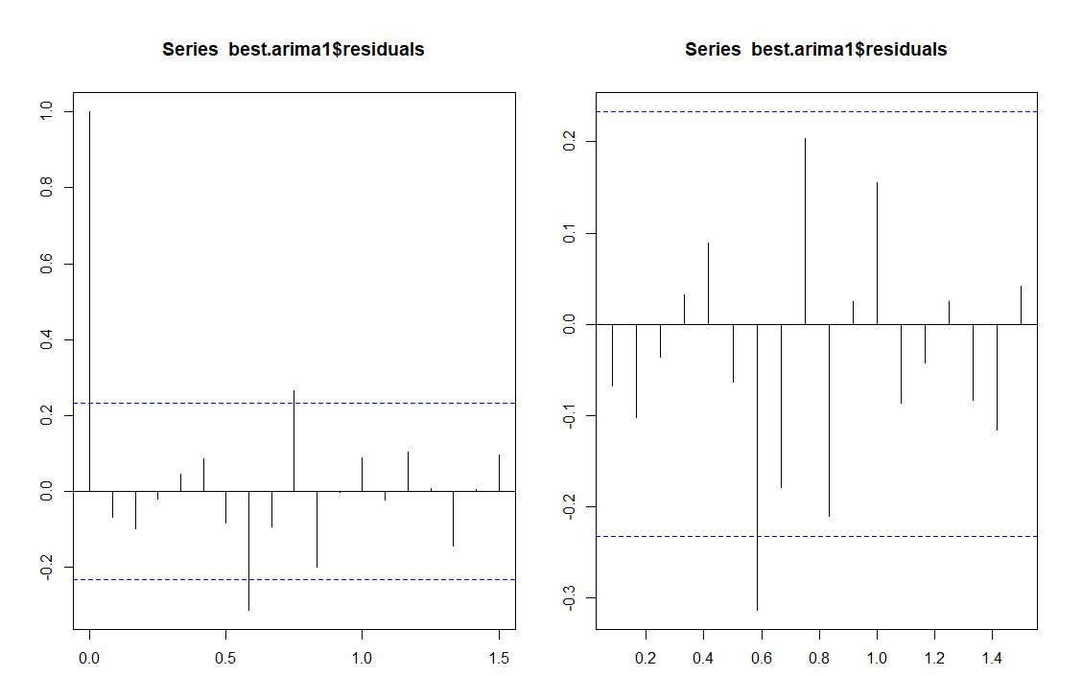
ARIMA MODEL
I have used for loop function and auto ARIMA model to get best order for the ARIMA model.
The below is the ACF and PACF of the residuals of the predicted ARIMA model.
We can see there is an lags and autocorrelation .

Slide 10
REJECT ARIMA MODEL
The Ljung-Box test is used to check if exists autocorrelation in a time series.
Box-Ljung test is performed which gives p value-0.4966, which fails to reject Null hypothesis.
The mean absolute percentage error of the predicted ARIMA model for Tesla and Volkswagen stock is calculated.
The MAPE of Volkswagen is around 109.95 which is too high and not a good model.
The MAPE of Tesla is around 94.8 which is also too high and is not a good model.
The residuals of the Predicted ARIMA model seems to have lags.
Thus we can conclude that this is not a good model to predict the future values of Tesla and Volkswagen stock price.

Slide 11
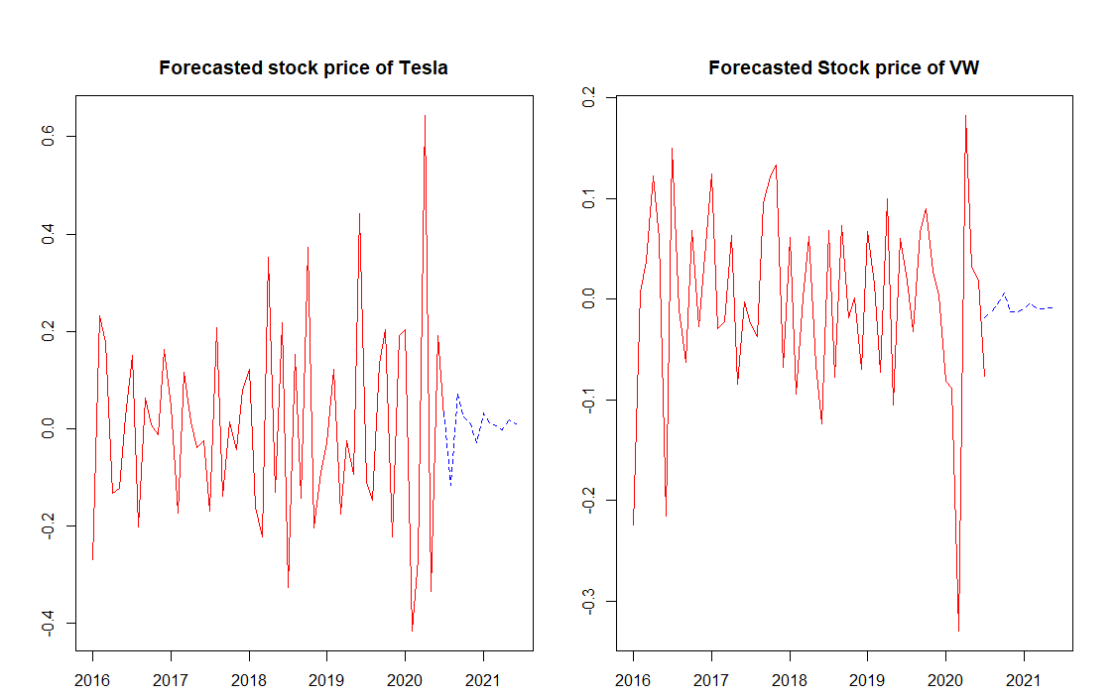
VECTOR AUTO REGRESSION MODEL
The VAR model is implemented to forecast the 12 months ahead values.
The ACF and PACF of the residuals of the predicted values doesn’t have any autocorrelation
The predicted values is plotted to predict the future values.

Slide 12
CONCLUSION
From the above graph we can see that for the year 2021 the value of stock price of Tesla is predicted to have up and down trend.
The first few month is predicted the price will fall down and then the next few months the price is likely to go upward trend, I suggest that end of 2020 is predicted good time to invest in Tesla stock.
The value of stock price of Volkswagen is predicted to have slight up and down trend the first few month is predicted the price will increase and then the next few months the price is likely to go downward trend and remain the same.
I suggest that the next year is not a good time to invest in Volkswagen stock.
From this analysis we can predict that Tesla stock value seems to go higher than Volkswagen Stock price, and for my data VAR seems to best fit compare to Linear Regression and ARIMA model.
For the future work, we will try to model it using more different approach like SARIMA, TBATS model etc.

Slide 13
Thank You

